Slide 1

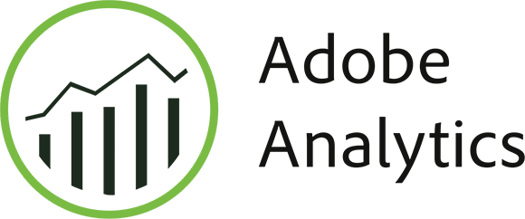
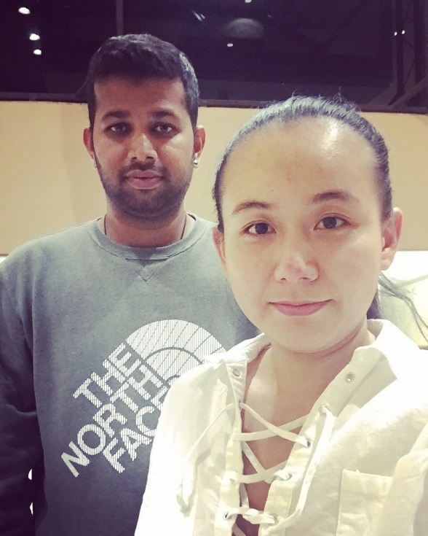
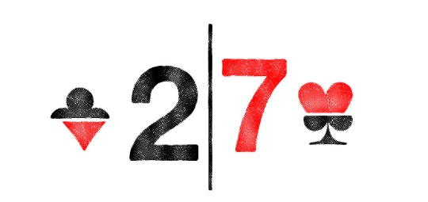
Team Name:
Team Member: Aditya Thakur & Yifan Yin
Faculty Name: Josh Friedman

Slide 2
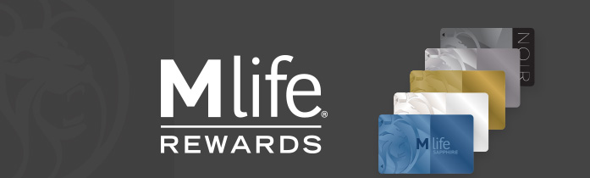
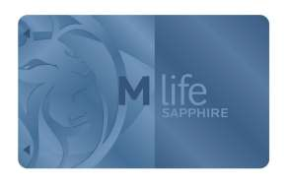
M life: Developing customer value Key business Objective - 1
The opportunities to increase future conversions/bookings
M Life members have higher customer values, compared to Non-Members
MGM should encourage Non-Members to sign up for the M Life membership

Slide 3
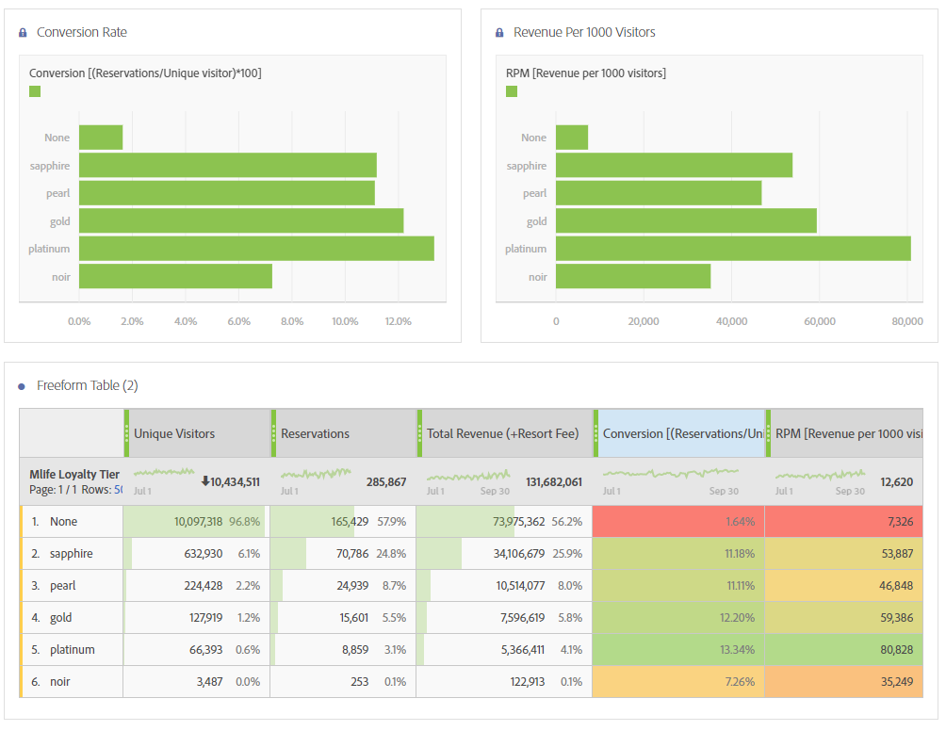

Sign up M life!
The block in ‘Red’ shows the conversion for visitors without a M Life Membership whereas the ones in shades of green are the conversion rates for different tiers of M Life membership
M Life members are generating more revenue as compared to Non members
As we can observe, there is a difference of around 10% in conversions for members vs non members.
Take Sapphire membership as an instance which is free. The members show a conversion of 11.18% which is very big compared to the default 1.64%
*Conversion rate formula: (Reservations/Visitors)/100
**RPM: Revenue per 1000 visitors

Slide 4
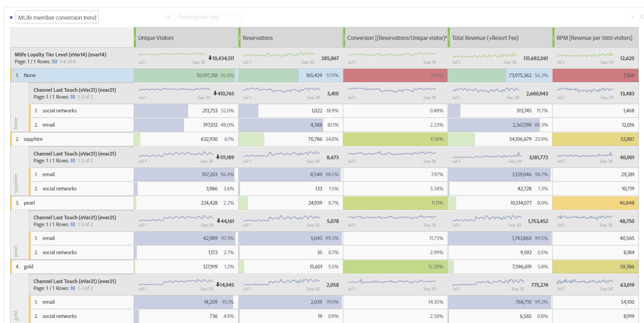
Sign up M life!
If we observe the way visitors react to Email and Social Media campaigns based on their loyalty tier status
Have a look at the difference in percentages for response rate for the promotional campaigns of:
Non Members vs Sapphire members
Enrolled M Life members are much more likely to respond to Emails and social media posts compared to non-members
Recommendation:
MGM should try and target the non members and convince them to become a member of the M Life program
Incentives and various promotional strategies can be used to encourage the user to sign up for the same

Slide 5
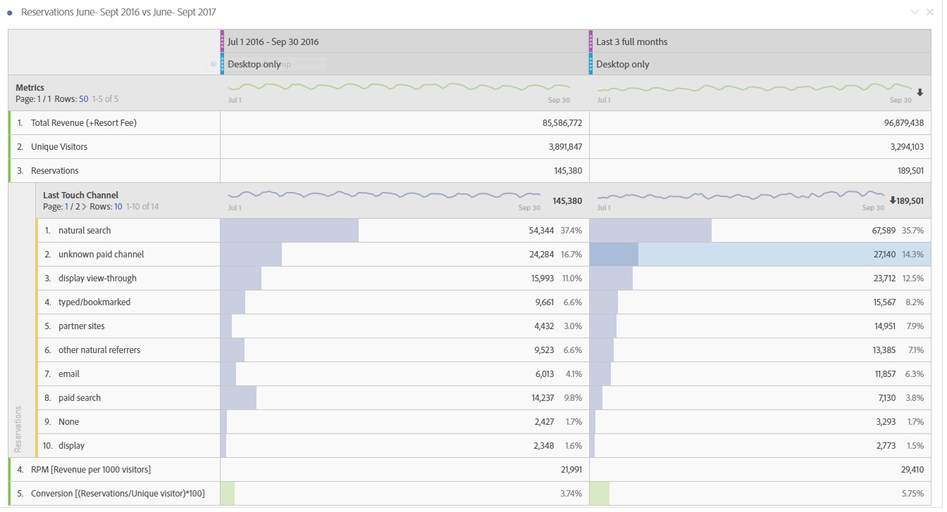
encourage sign up via partner site & email
Once again take a look at the conversion rate for Sept 2016 vs Sept 2017
We see a conversion rate increase of about 2% compared to last year
How much impact has it had on the overall business though
Even though we have seen a slight drop in the visitors visiting MGM grand from the Desktop, look at the impact, the successful conversion of reservations has had on the overall revenue
Recommendation:
Opportunities to target certain segments such as Partner sites and Email should be explored as they generally show a higher conversion rate

Slide 6
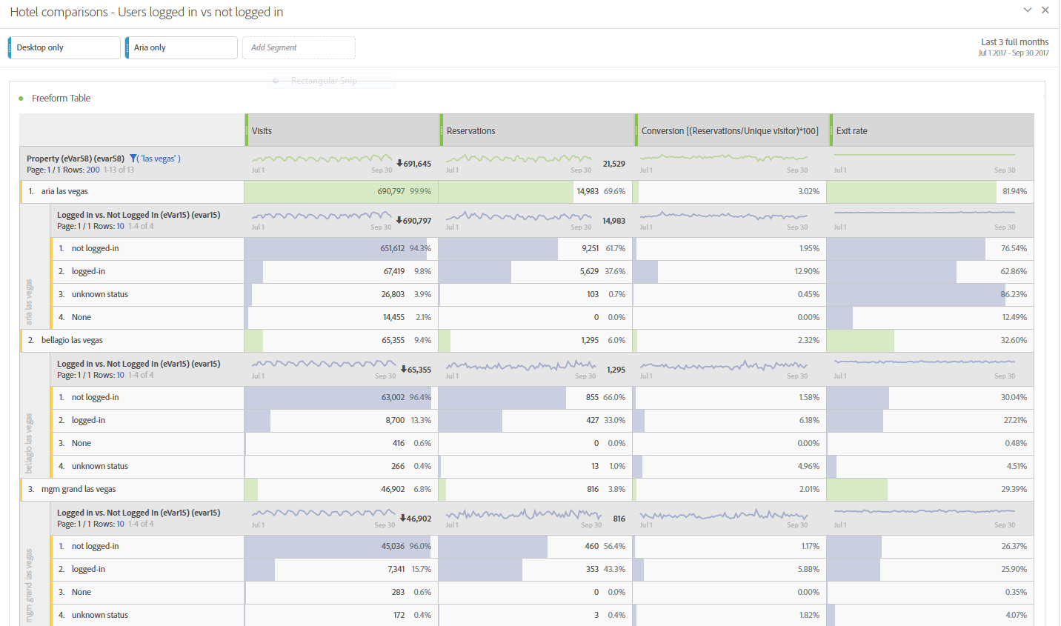
Login vs Not logged in
Comparing the importance of customer to sign-up and login based on different MGM properties
Aria, One of the most popular property in this chain has a conversion rate of 3.02%
Now if we dive deeper and try to segregate the percentage based on the login status of the user- we find out another observation to support our hypothesis
Not logged in user – 1.95% CTR
Logged in user – 12.90% CTR
Recommendation:
So the trend as we speak is as try to build a customer relationship. Get them to sign up, get them to download the app and try to get their user preferences.
Registered users tend to have a higher conversion rate and account for a higher percentage of the revenue in the longer run

Slide 7
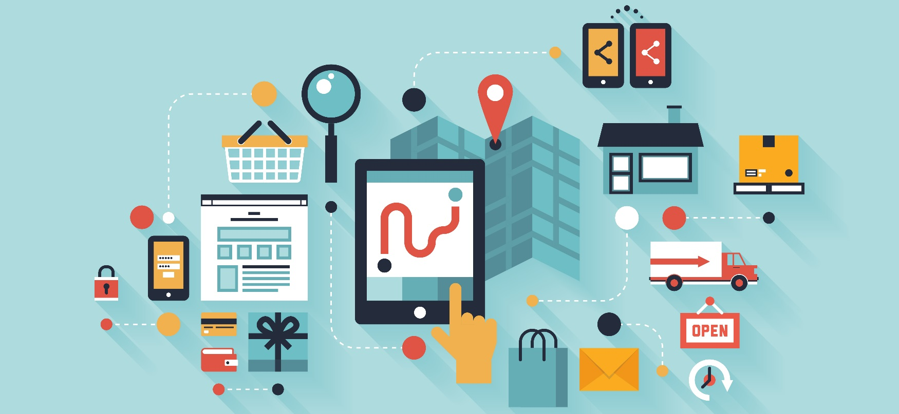
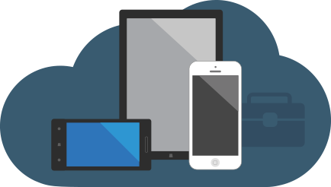
Mobile user Behavior Key Business Objective - 2
Mobile App Opportunities for Vegas Market
Mobile phone visits and bookings are increasing considerably
High time to optimize the user experience and promote the MGM Resorts App

Slide 8
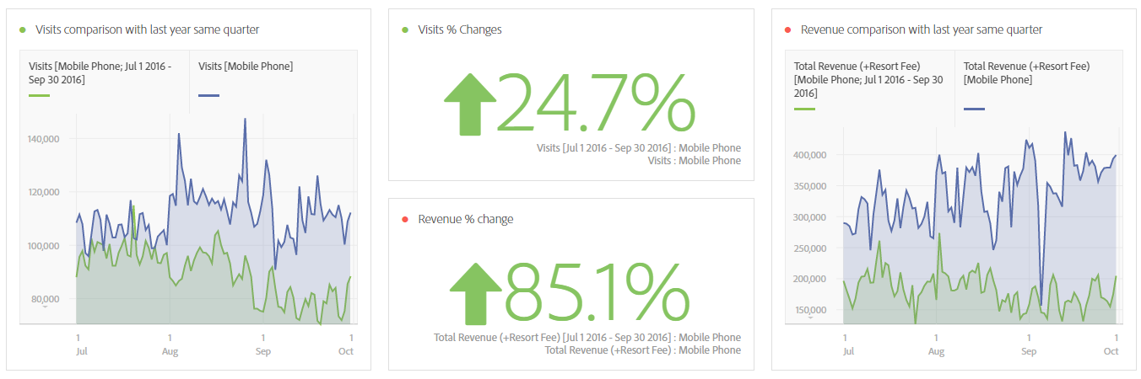
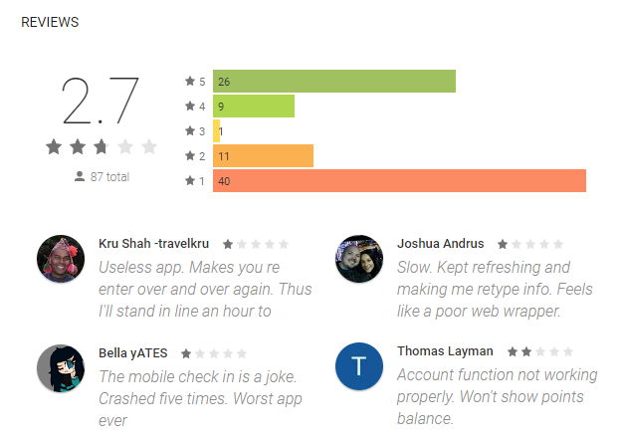
MGM Mobile market is Booming!
Compared to last year same quarter, 6.2% of visits shift from desktop to mobile phone
Visits of mobile phone increase 24.7% and bring in 85.1% more revenue
RECOMMENDATION:
High time to optimize the mobile app user experience, then promote the App via home page and other channel, such as social media and email
* Mobile App: Our team focus on the MGM Resorts International mobile application

Slide 9
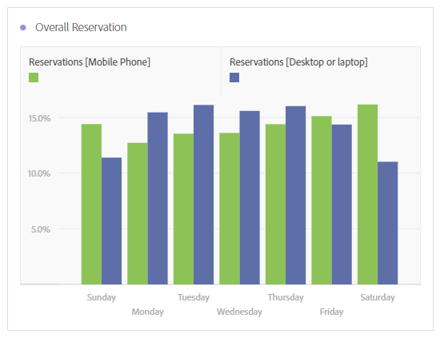
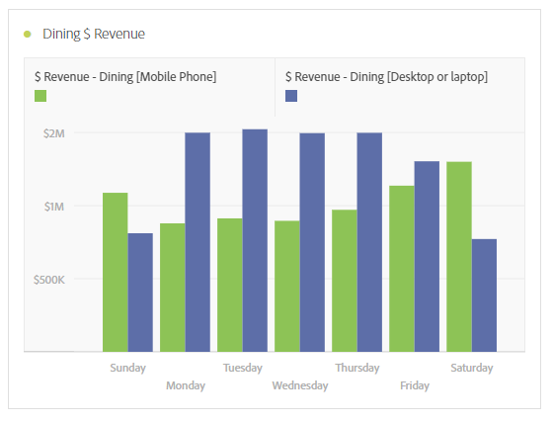
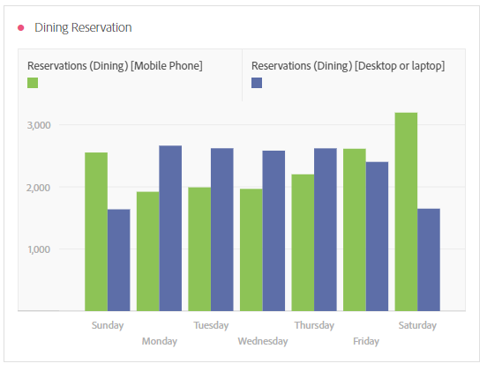
“I am booking the restaurant, right now”
Compared to Desktop reservations, the overall Mobile Phone* reservation surpass Desktop on Fridays and Weekends
Even the mobile phone dining reservations surpass the Desktop reservations on Friday and Weekend
People are booking restaurant at Vegas using their phone!
* Due to lack of Mobile App data from Adobe, our team applied the mobile device type for in-depth analysis

Slide 10
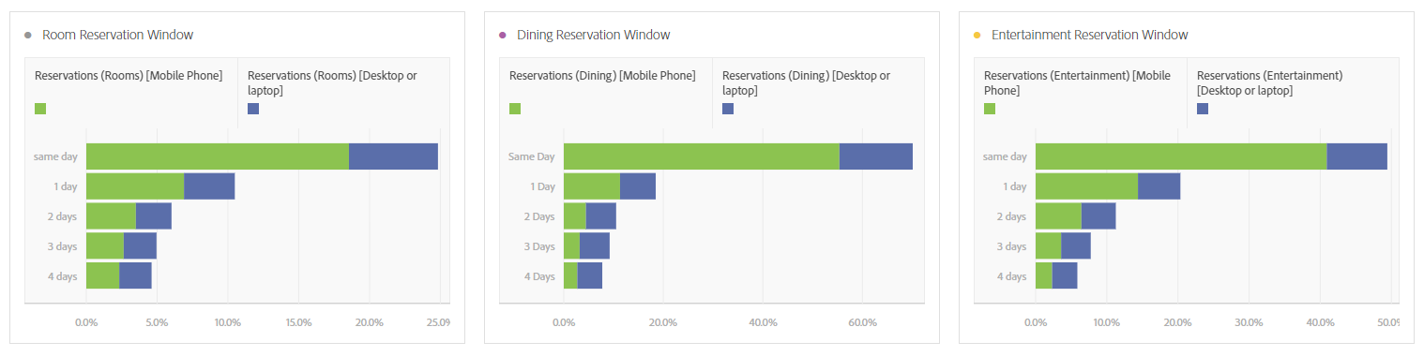
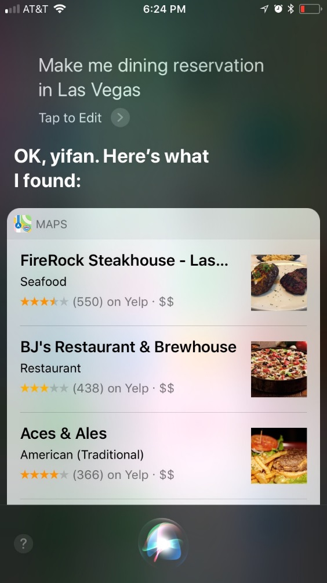
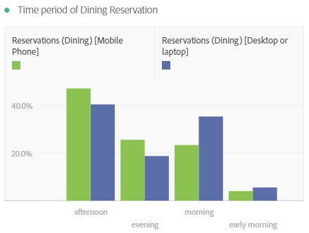
“Siri, make an reservation tonight in Vegas”
Mobile Phone Users
are making dining and entertainment reservations when they are visiting Las Vegas, and they are looking for restaurant and events for Today and Tomorrow
RECOMMENDATION:
Push App notifications of dining and events recommendations according to customer check-in day and favorite items. Push dining recommendations during the afternoon and evening to increase the table occupation rates

